Slide 1
DPM Final Project – Week 4
TEAM 11

Slide 2
Gantt Chart Update
Refer to Application

Slide 3
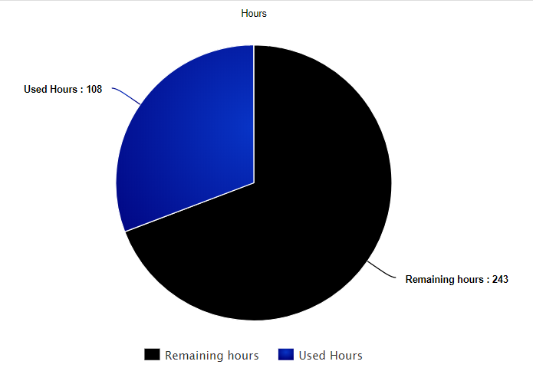
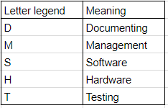
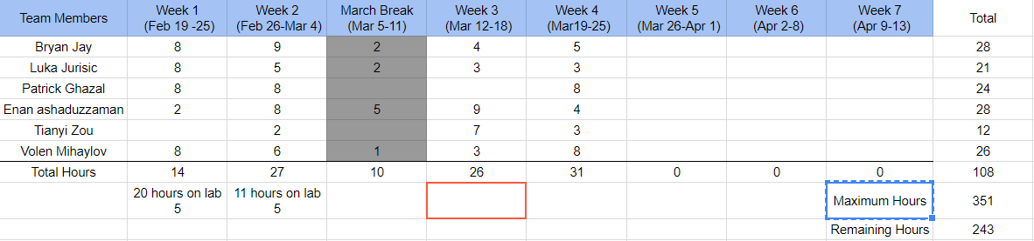
Budget Update

Slide 4
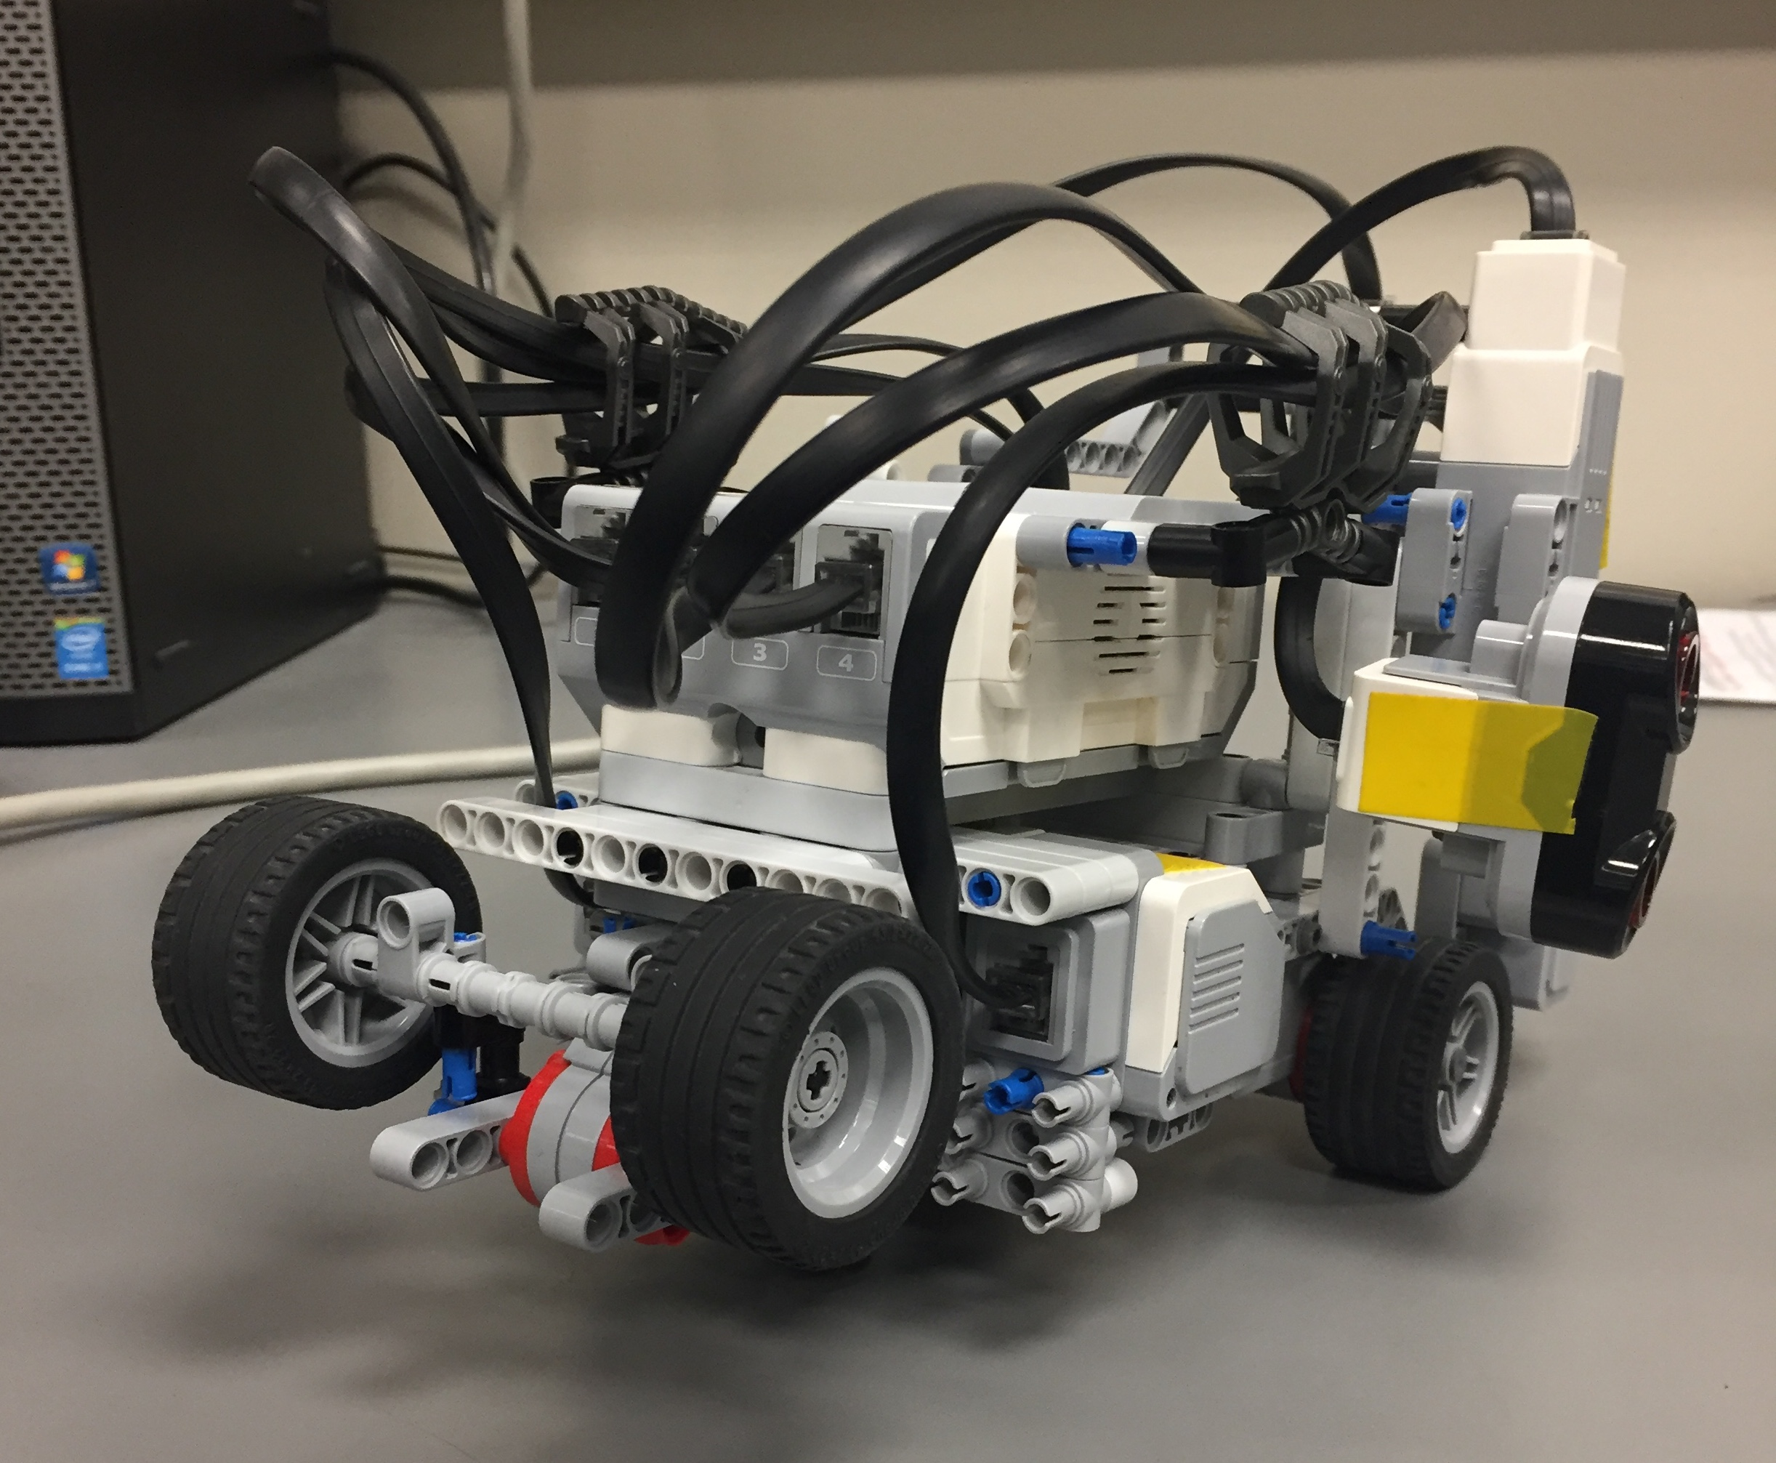
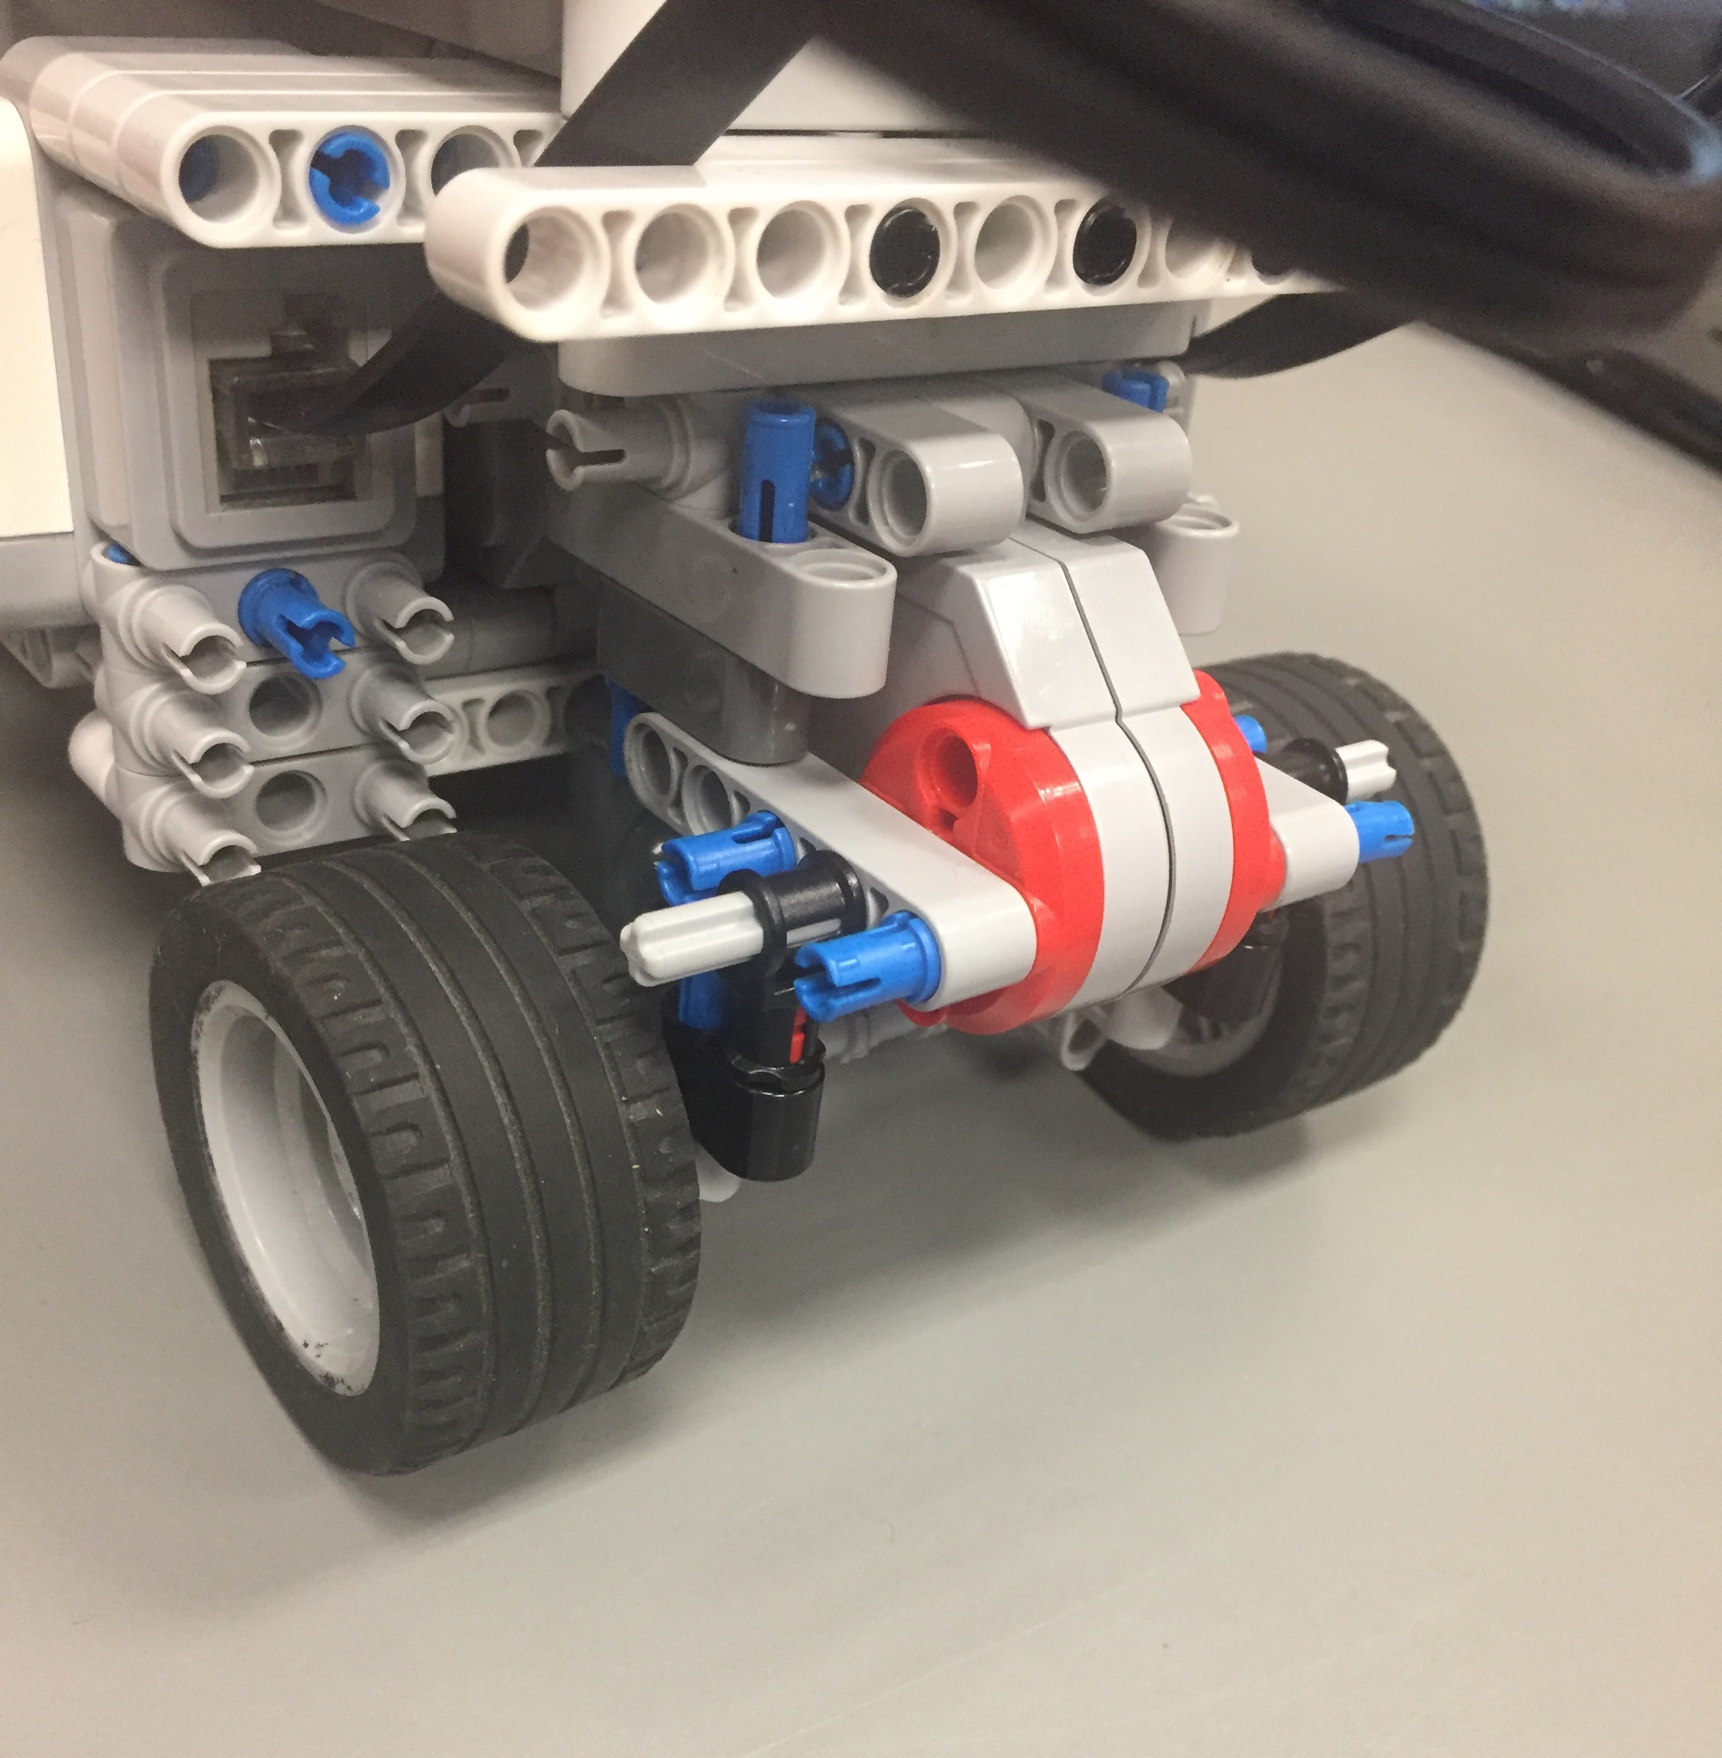
Design Changes
Robot was only able to cross the bridge when the rear wheel was stable. (Marble was ineffective from previous testing)
Problem: The robot CANNOT localize with a stable rear wheel.
Solution: Implement a mechanism which deploys the rear wheels only when it localizes towards the bridge.

Slide 5
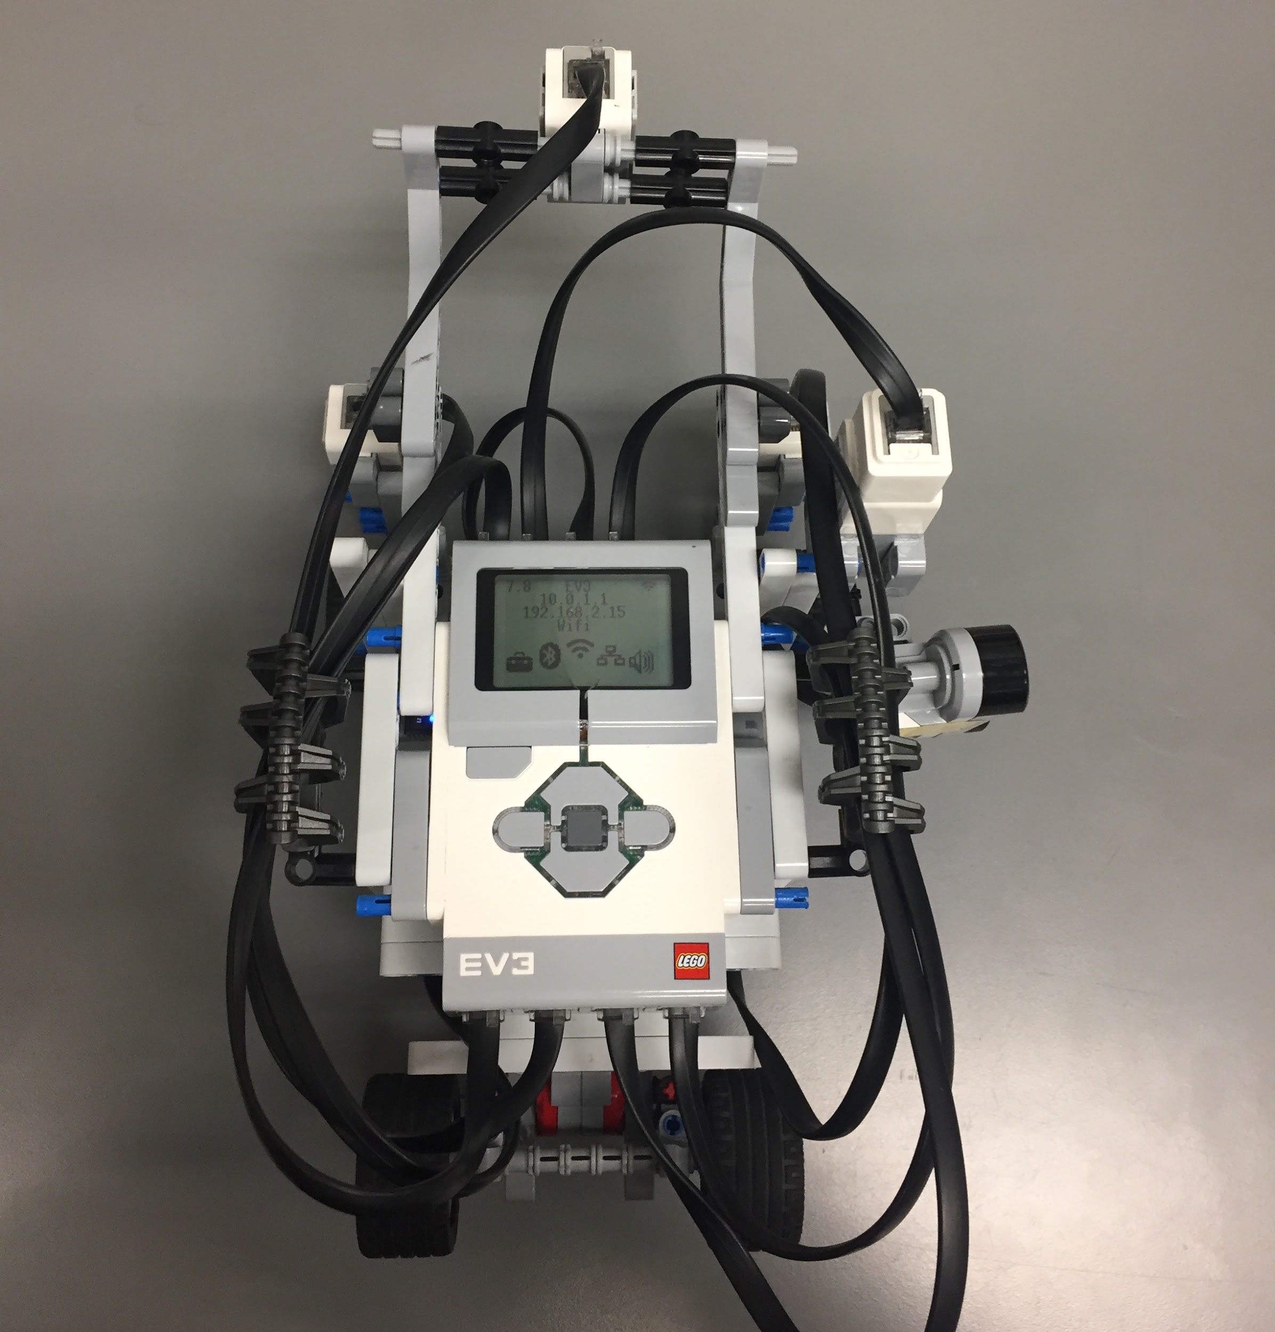
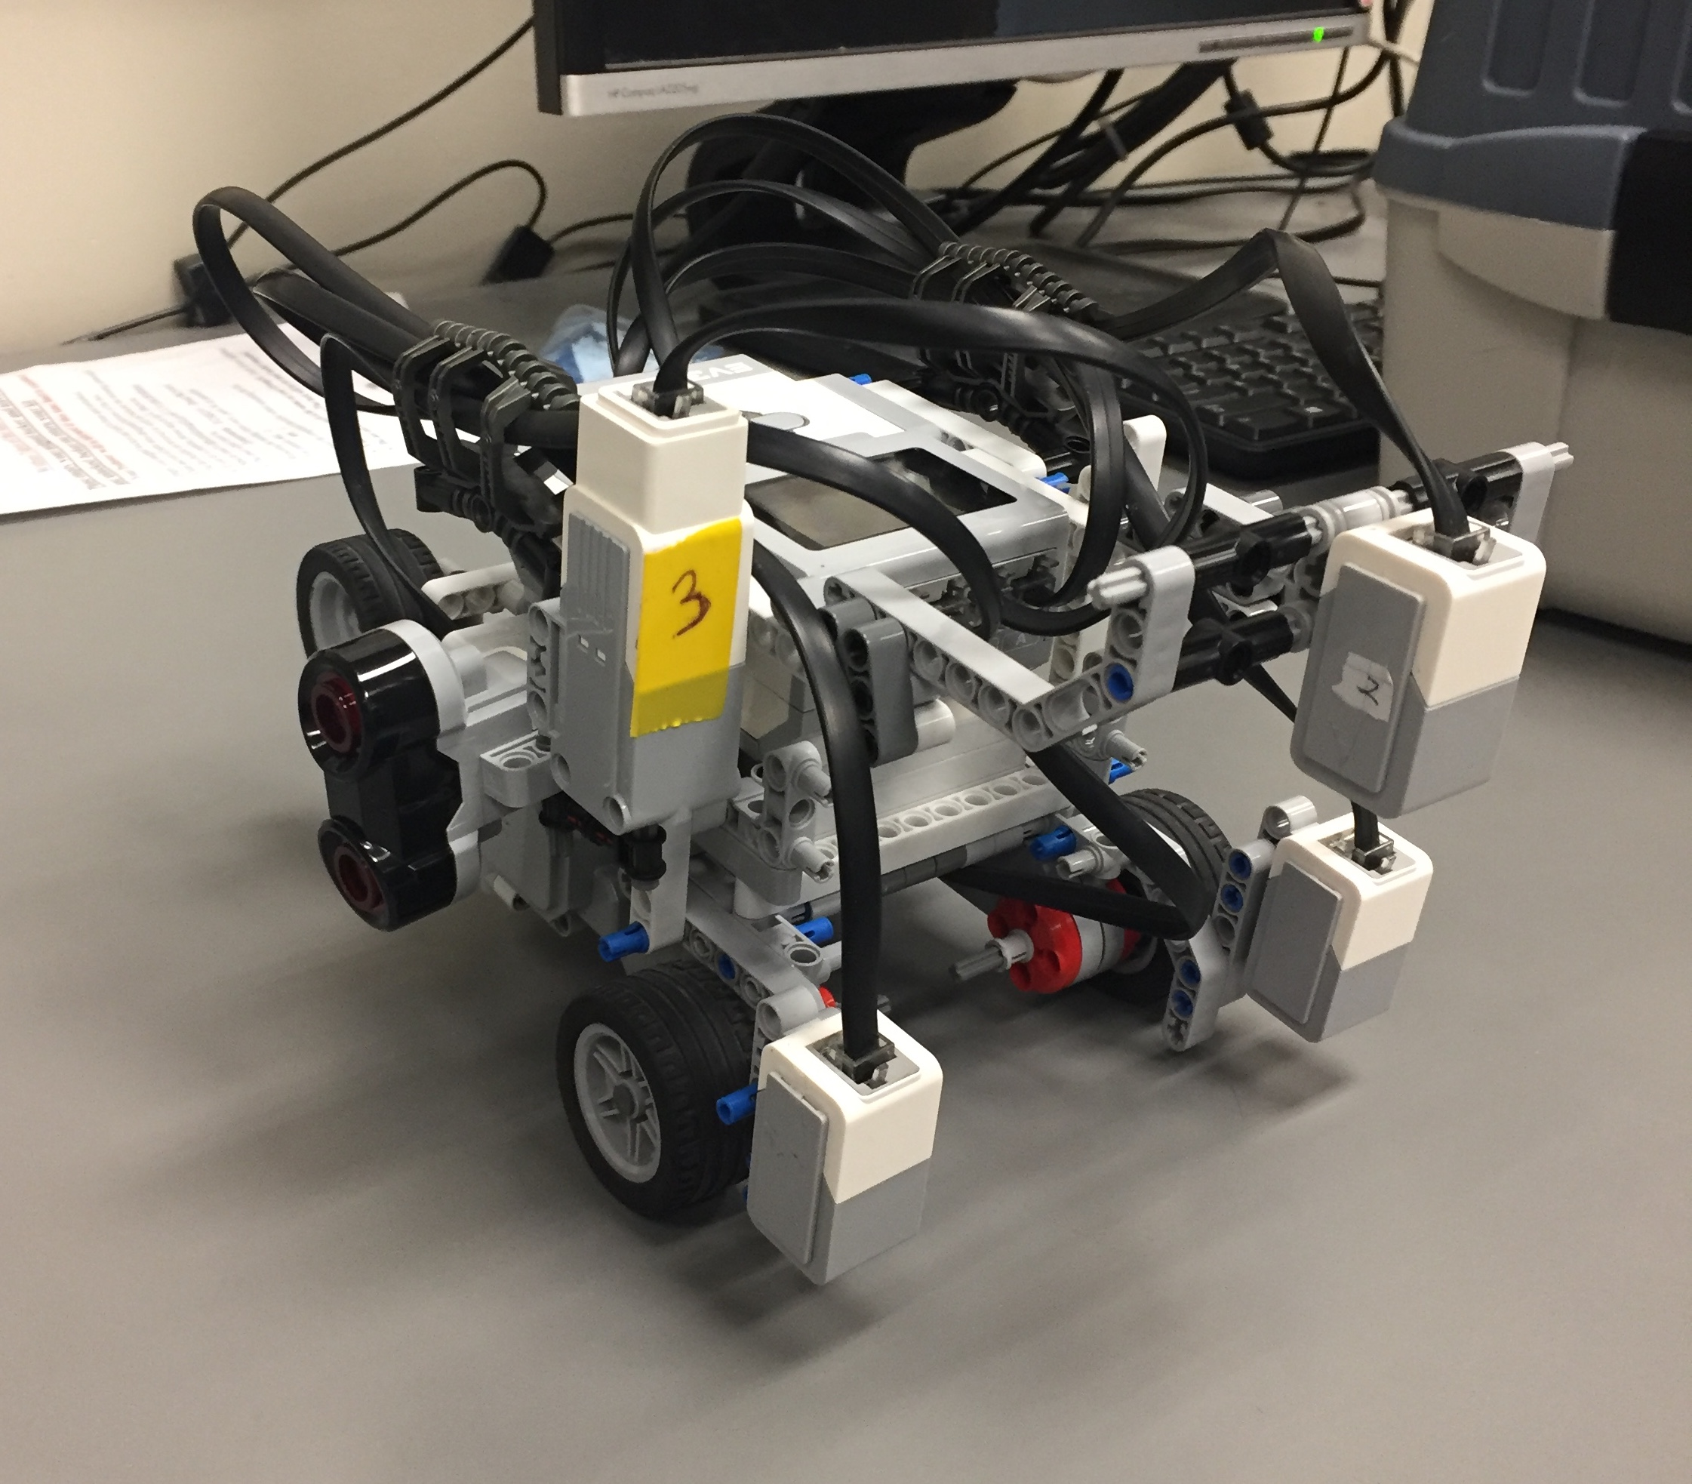
Design Changes
Every other aspect of the robot was added from Preliminary Design Number 2. Attached every motor and sensor to the robot.
Created the stable light sensor (10.9cm off the ground) so that the light sensor is always being used at its optimal distance.
Chassis: Due to all the sensors and motors, the robot had a very unstable chassis. Additional lego pieces had to be added towards the chassis in order to make it as rigid as possible.

Slide 6
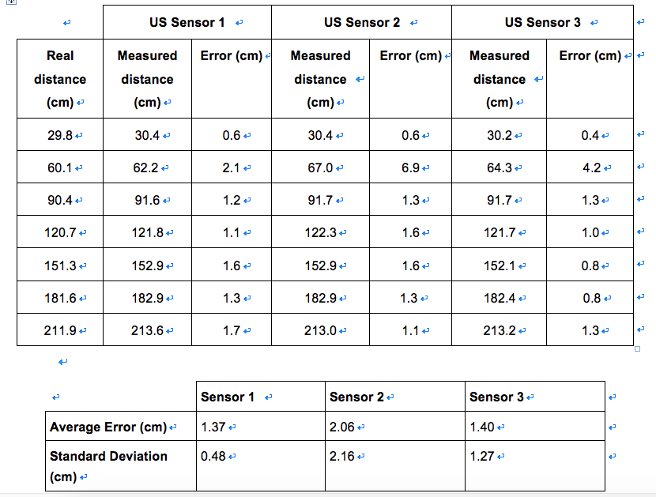
Testing Design Update
Tested track of updated robot
All tests are done at a battery charge of 8V.
Tweak the track value and measure the error in angle
Action: Keep the value at 12.7cm unless any changes on hardware
Tested US sensor
All tests are done at a battery charge of 8V.
Tweak the track value and measure the error in angle
Action: Keep the value at 12.7cm unless any changes

Slide 7
Testing Design Update
Tested its ability to put down the extra wheel
Tested ability to cross bridge
Tested for Angle constant
Tested for Distance constant

Slide 8
Software Class Hierarchy

Slide 9
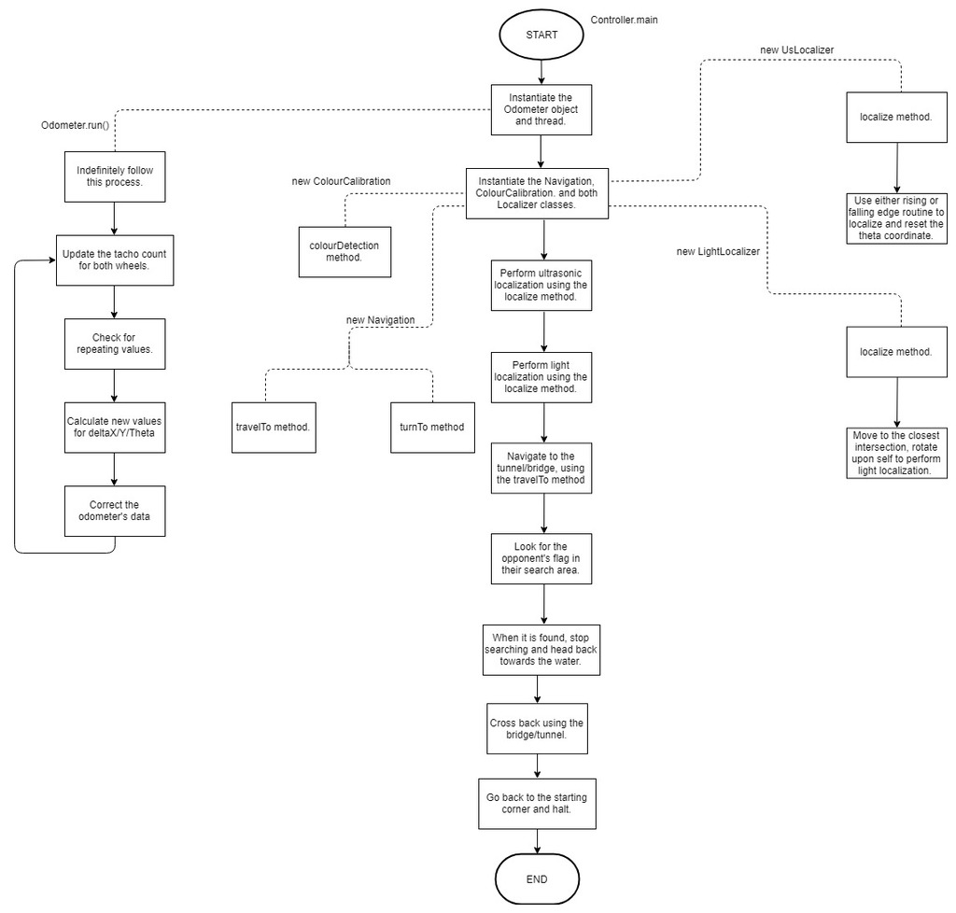
Software Flowchart
Breakdown of flowchart for Final project

Slide 10
API Documentation
JAVA Docs
Up to date.
Refer to HTML files

Slide 11
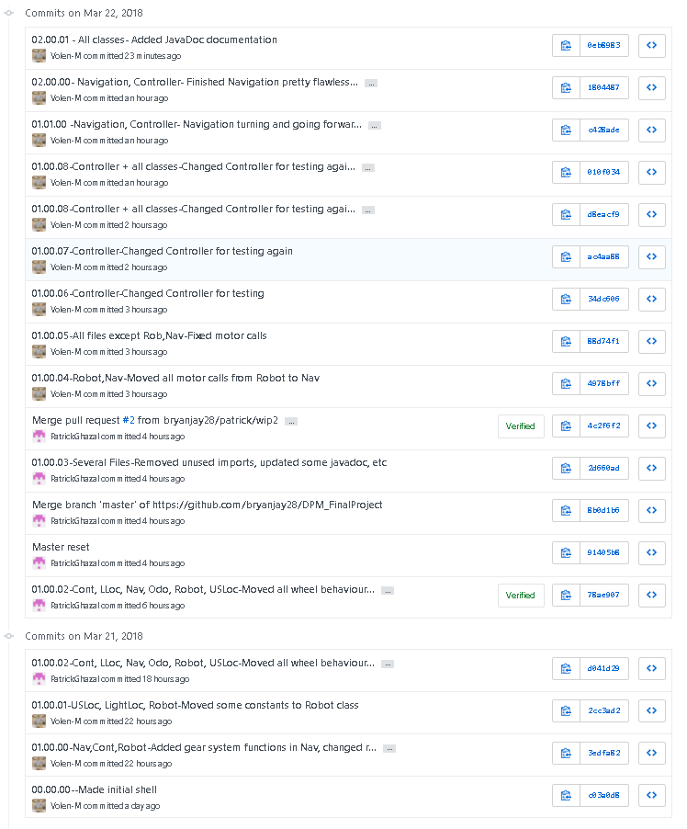
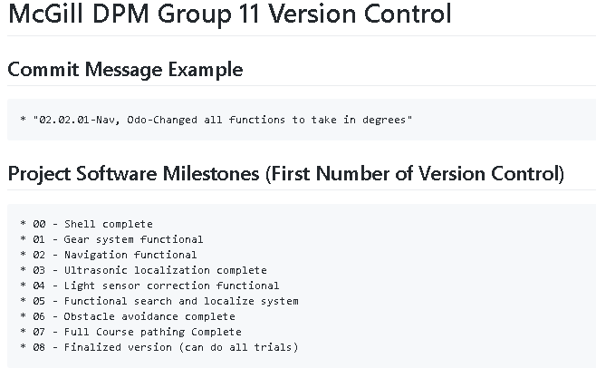
Status of Code
= Behind

Slide 12
Next Steps
Push on software to catch-up
Testing software components as they are completed
Full end-to-end testing for demo
Update documentation based on improvements and tests

Slide 13
Any Questions?

